Slide 1
Data Structures
DS Lecture – Linked List

Slide 2
Introduction to Linked list data structure
linked list is a data structure consisting of a group of nodes which together represent a list i.e. a sequence of data.
43
44
41
47
45
43
44
41
47
45
FF00
FF04
FF08
FF0C
FF10
45 | NULL | FF00
44 | FFFF | FFF1
47 | FF00 | FF0X
43 | FFF1 | FF1F
41 | FF0X | FFFF
Start
List
Array
Linked list

Slide 3
Starting point (head)
Node 1
address
Node 1
43 | Node 2 address
Node 3
41 | Node 4 address
Node 2
44 | Node 3 address
Node 4
47 | Node 5 address
Node 5
45 | NULL

Slide 4
Head pointer
FF1F
Node 1
43 | FFF1
Node 3
41 | FF0X
Node 2
44 | FFFF
Node 4
47 | FF00
Node 5
45 | NULL

Slide 5
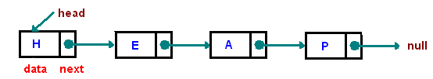
Basics of Linked Lists
A group of nodes.
Each node represents by a block of memory and it has two fields/parts:
  data/value and
  a next pointer to point the next node.
We need to build a new data type for this node which will have two fields, one for data and another for a pointer. Struct can be used for this purpose.

Slide 6
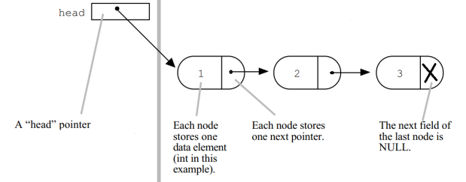
Data type for a node of Linked Lists
Node
  Each node of the list contains
    the data item and
    a pointer to save the next node’s address
data
next
data type is ListNode
struct ListNode
{
int data;
struct ListNode *next;
};
Struct ListNode node1;
typedef struct ListNode {
int data;
struct ListNode *next;
}Nodetype;
Nodetype node1;

Slide 7

Data type for a header pointer
The entry point into a linked list is called the head of the list.
head is only a reference to/address of the first node of the list but not a separate node.
If the list is empty then the head is a NULL reference.
The last node has a reference to NULL.

Slide 8
Data type for a header pointer
This structure has a starting pointer to the list called First /head
  Initially NULL
head
  NULL
typedef struct ListNode {
int data;
struct ListNode *next;
}* nodeptr;
nodeptr head;
head = NULL;
struct ListNode {
int data;
struct ListNode *next;
};
struct ListNode *head;
head = NULL;
A pointer variable of ListNode data type

Slide 9
How to allocate memory for a node?
A linked list is a dynamic data structure.
  The number of nodes in a list is not fixed and can grow on demand.
  Any application which has to deal with an unknown number of objects will need to use a linked list.
  For the allocation of each node we will use the operator new to dynamically allocate space in C++.
  nodeptr newNode = new ListNode;
  Here, newNode is a pointer which point or reference a new memory block i.e. a reference of a new node.
newNode
data
Next

Slide 10
How to create a Link list?
head is a pointer to the list to point the first node.
newNode
Reference of new node
head
  NULL
data
Next
typedef struct ListNode {
int data;
struct ListNode *next;
}* nodeptr;
nodeptr head = NULL;
  nodeptr newNode = new ListNode;
Space allocation for a node

Slide 11
How to create a Link list?
newNode
head
typedef struct ListNode {
int data;
struct ListNode *next;
}* nodeptr;
nodeptr head = NULL;
  nodeptr newNode = new ListNode;
head = newNode;
data
Next
head is linked to first node

Slide 12
How to create a Link list?
newNode
head
typedef struct ListNode {
int data;
struct ListNode *next;
}* nodeptr;
nodeptr head = NULL;
  nodeptr newNode = new ListNode;
newNode -> data = 43;
newNode -> next = NULL;
head = newNode;
43
  NULL
data field and
next pointer are
set by value and
null, respectively.

Slide 13
How to create a Link list?
typedef struct ListNode {
int data;
struct ListNode *next;
}* nodeptr;
nodeptr head = NULL;
  nodeptr newNode = new ListNode;
Head = newNode;
newNode -> data = 43;
newNode -> next = NULL;
nodeptr curr;
curr = head;
// OR we can write curr = newNode;
newNode
head
43
curr
  NULL
curr pointer is
also pointing the
new node

Slide 14
Type of Linked list
Singly linked list (that has single references)
Doubly linked list (that has two references)
Multiply linked list (that has more than two references)
Circular list (tail element's next pointer points to the head element)

Slide 15
Singly Linked Lists
Add first item
  Allocate space for node
  Set its data field by data value
  Set Next pointer to NULL
  Set head to point to new node
  Set current point as head
typedef struct ListNode {
int data;
ListNode* next;
}* nodeptr;
nodeptr head = NULL, curr;
nodeptr newNode = new ListNode;
newNode->data = 43;
newNode->next = NULL;
head = newNode;
curr = head;
// curr = newNode;
newNode
head
43
Next
curr
  NULL
Dr. Kazi A. Kalpoma

Slide 16
Singly Linked Lists
Add second item
  Allocate space for node
  Set its data pointer to object data
  Set Next to NULL
  Set current next point to new node
  Set current to new node
nodeptr newNode = new ListNode;
newNode->data = 44;
newNode->next = NULL;
curr->next = newNode;
curr = newNode;
head
newNode
next
Next
43
44
curr
  NULL
curr has moved to 2nd node

Slide 17
Add third item
  Same as second item
nodeptr newNode = new ListNode;
newNode->data = 41;
newNode->next = NULL;
curr->next = newNode;
curr = newNode;
head
43
next
44
next
newNode
41
Next
curr
  NULL

Slide 18
Add n items………need to use a loop??
int item;
for( int i=0 ; i < n ; i++ )
{
cin >> item;
nodeptr newNode = new ListNode;
newNode->data = item;
newNode->next = NULL;
if(head==NULL){
head = newNode; //when first node.
}
else {
curr->next = newNode;
}
curr = newNode;
}

Slide 19
“AddData” function to Create a Linked List
void AddData (int item)
{
nodeptr newNode = new ListNode;
newNode->data = item;
newNode->next = NULL;
if(head==NULL){ // for the first node
head = newNode;
}
else {
curr->next = newNode;
}
curr = newNode;
}
typedef struct ListNode {
int data;
ListNode* next;
}* nodeptr;
nodeptr head = NULL, curr;
void main()
{
AddData(43);
AddData(44);
AddData(41);
}

Slide 20
Traversing (display) a linked list
head
ptr
43
next
44
next
void display()
{
nodeptr ptr = head;
while (ptr != NULL)
{
cout << ptr->data << “ “ ;
ptr = ptr->next ;
}
cout << endl;
}
41
Next
  NULL
OUT PUT:
43 44 41

Slide 21
Answer the following meanings:
nodeptr ptr = head;
cout << ptr->data;
cout << ptr->next->data;
cout << ptr->next->next->data;
ptr=ptr->next->next;
cout << ptr->data;
ptr->next = head;
cout <<ptr->next->data

Slide 22
Example of linked list creation and print of the list.
void display(nodeptr ptr );
typedef struct ListNode {
int data;
struct ListNode* next;
}* nodeptr;
void main()
{
int item;
nodeptr head = NULL, curr;
for(i=1;i<=n;i++){
cin >> item;
AddData(item);
}
display(head);
}
void display(nodeptr ptr )
{
while (ptr != NULL)
{
cout << ptr->data << “ “ ;
ptr = ptr->next ;
}
cout << endl;
}
OUT PUT:
12 99 37

Slide 23



Search an item in to linked list
head
ptr
typedef struct ListNode {
int data;
ListNode* next;
}* nodeptr;
void main()
{
nodeptr head = NULL, curr;
AddData(12);
AddData(99);
AddData(37);
cin>>item;
Search(item);
}
void Search (int item)
{
nodeptr ptr = head;
while(ptr->data != item && ptr->next !=NULL)
ptr = ptr->next;
if(ptr->data==item)
cout << item << “found”;
else
cout<< item<<“ not found”;
}
Dr. Kazi A. Kalpoma

Slide 24

Modification of “AddData” function to “Insertion” function.
  A new item insertion in to a linked list can be placed the item in different locations as follows:
  Inserting item at the beginning
  Inserting item somewhere in the middle
  Inserting item at the end
head
20
newptr
Dr. Kazi A. Kalpoma

Slide 25
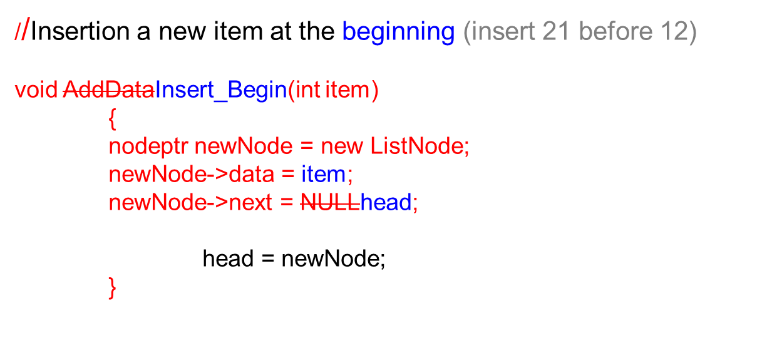







head
  NULL
head
  NULL
Dr. Kazi A. Kalpoma

Slide 26



  //Insertion a new item somewhere in the middle (insertion 21 after 12)
Void Insert_Mid (int item)
{
nodeptr newNode = new ListNode;
newNode->data = item;
nodeptr ptr = head;
while(ptr->data != 12 && ptr->next !=NULL)
ptr = ptr->next;
if(ptr->data==12){
newNode->next = ptr->next;
ptr->next = newNode;}
else
cout<< “12 not found”;
}
head
ptr
  NULL
head
newNode
  NULL

Slide 27
  //Insertion a new item at the end
Void Insert_End (int item)
{
nodeptr newNode = new ListNode;
newNode->data = item;
newNode->next = NULL;
if(head==NULL){ // as first node
head = newNode;
}
else {
curr =head;
while(curr->next != NULL){
curr = curr ->next;
}
curr->next = newNode;
}
}
Dr. Kazi A. Kalpoma

Slide 28





Deletion a node from a linked list
head
Deletion a node can be for three different situations:
  Deleting the first node
  Deleting a node somewhere in the middle
  Deleting the last node
  NULL
head
  NULL
head
  NULL
head
  NULL

Slide 29
First node deletion
head
ptr
  NULL
void first_node_dlt()
{
nodeptr ptr= head;
head = ptr->next;
delete(ptr);
}
Dr. Kazi A. Kalpoma

Slide 30


Middle node deletion
head
ptr
  NULL
dptr
void middle_node_dlt(int item)
{
nodeptr ptr = head, dptr;
while(ptr->next->data != item && ptr->next !=NULL){
ptr= ptr->next;
}
dptr = ptr->next;
ptr->next = ptr->next->next;
delete(dptr);
}
Dr. Kazi A. Kalpoma

Slide 31



Last node deletion
head
ptr
  NULL
dptr
Void Last_node_dlt()
{
nodeptr ptr= head, dptr;
while(ptr->next->next!=NULL)
ptr=ptr->next;
dptr = ptr->next;
ptr->next = NULL
delete(dptr);
}
Dr. Kazi A. Kalpoma

Slide 32
Advantages:
dynamic data structure, allocating the needed memory when the program is initiated.
Insertion and deletion node operations are easy.
can be used to implement several common abstract data types and stacks, queues, associative arrays etc.
reduced access time and but expanded in real time without memory overhead.
Disadvantages:
They have a tendency to waste memory due to pointers requiring extra storage space.
Nodes in a linked list must be read in order from the beginning as linked lists are inherently sequential access.
Nodes are stored in-contiguously, greatly increasing the time required to access individual elements within the list.
Difficulties arise in linked lists when it comes to reverse traversing. Singly linked lists are extremely difficult to navigate backwards, and while doubly linked lists are somewhat easier to read, memory is wasted in allocating space for a back pointer.

Slide 33
Two-way linked lists
One that can be traversed in both directions – forward and backward
Every node has two pointers:
  One pointing to the next node (except the last node)
  One pointing to the previous node (except the first node)
Two external pointers - head and tail
Dr. Kazi A. Kalpoma

Slide 34
Two way or Doubly Linked Lists
  Each node of the list contains
    the data item (an object)
    a pointer to the next node
    a pointer to the previous node
typedef struct ListNode {
int data;
struct ListNode* next;
struct ListNode* prev;
}*nodeptr;
prev
data
next
ListNode
Dr. Kazi A. Kalpoma

Slide 35
Two-way linked list of integers
  NULL
head
tail
3
7
12
  NULL
Dr. Kazi A. Kalpoma

Slide 36
Advantages and disadvantages
Advantages
  The list can be traversed in both directions
  Can access an object to the left/right
  Some insertion and deletion become easier
Disadvantages
  Require more space for each node
Anything you can do with a one-way linked list can be done with a two-way linked list; but not vice-versa.
Dr. Kazi A. Kalpoma

Slide 37
Creating a two-way list
Declare head and tail pointers and initialized with NULL:
typedef struct ListNode {
int data;
ListNode* next;
ListNode* prev;
}* nodeptr;
head
tail
  NULL
  NULL
nodeptr head, tail;
head = NULL;
tail = NULL;
Dr. Kazi A. Kalpoma

Slide 38
Creating a two-way list (cont ..)
Create the first node with value 3:
nodeptr nwNd = new ListNode;
nwNd->data = 3;
nwNd->prev = NULL;
nwNd->next = NULL;
head = nwNd;
tail = nwNd;
// tail = nwNd;
head
tail
3
nwNd
Dr. Kazi A. Kalpoma

Slide 39
Linked Lists
Create the second node with value 5:
nodeptr nwNd = new ListNode;
nwNd->data = 5;
nwNd->prev = tail;
nwNd->next = NULL;
tail>next = nwNd;
tail = nwNd;
head
3
  NULL
tail
  NULL
ptr
5
nwNd
Dr. Kazi A. Kalpoma

Slide 40
Inserting nodes in a two-way list
Requires changes in more pointers
Steps:
  Find the place to insert
  Create the new node
  Adjust the pointers
Can be done in different ways:
  Inserting at the beginning
  Inserting somewhere in the middle
  Inserting at the end (done)
Dr. Kazi A. Kalpoma

Slide 41
Inserting a node at the beginning of the list
Insert a node with value 5 at the beginning of the following list
  NULL
head
tail
3
  NULL
Dr. Kazi A. Kalpoma

Slide 42
Step 1
Create up a new node with value 5
nwNd
5
  NULL
  NULL
Dr. Kazi A. Kalpoma

Slide 43
Step 2
Make necessary changes to the pointers
head
tail
nwNd
3
5
head
tail
3
nwNd
5
  NULL
Dr. Kazi A. Kalpoma

Slide 44
Inserting a node somewhere in the middle
Insert a node with value 5 after the node pointed to by Ptr
Ptr
  NULL
head
tail
3
7
12
  NULL
Dr. Kazi A. Kalpoma

Slide 45
Step 1
Create up a new node with value 5
nwNd
5
Dr. Kazi A. Kalpoma

Slide 46
Step 2
Make necessary changes to the pointers
Ptr
head
tail
3
7
12
nwNd
5
Dr. Kazi A. Kalpoma

Slide 47
Traversing a two-way linked list
Same as the traversal in a one-way list, but
  Can start at the head
  Can start at the tail
Dr. Kazi A. Kalpoma

Slide 48
Deleting nodes from a two-way list
Requires changes in more pointers
Can be done in different ways:
  Deleting the first node
  Deleting a node somewhere in the middle
  Deleting the last node
Dr. Kazi A. Kalpoma

Slide 49
Deleting the first node
Delete the first node from the following list
head
tail
3
7
12
Dr. Kazi A. Kalpoma

Slide 50
Step 1
Make necessary changes to the pointers
head
tail
3
7
12
head
tail
3
7
12
Dr. Kazi A. Kalpoma

Slide 51
Step 2
Deallocate the space occupied by the deleted node
head
tail
3
7
12
Dr. Kazi A. Kalpoma

Slide 52
Deleting a target node
You have to first find the pointer to the target node
Delete the node pointed to by currPtr
curr
head
tail
3
7
9
12
Dr. Kazi A. Kalpoma

Slide 53
Step 1
Change the next pointer of the left node
Change the prev pointer of the right node
curr
head
tail
3
7
9
12
Dr. Kazi A. Kalpoma

Slide 54
Step 2
Deallocate the space occupied by the deleted node
curr
head
tail
3
7
9
12
Dr. Kazi A. Kalpoma

Slide 55
Deleting the last node
What will you need to do?
This is a homework assignment that you don’t need to turn in!!
Dr. Kazi A. Kalpoma

Slide 56
Linked lists vs Arrays
Advantages:
  Overflow can never occur unless the memory is actually full.
  Insertions and deletions are faster.
  With large objects, moving pointers is easier and faster than moving the objects themselves.
Disadvantages:
  The pointers require extra space.
  Do not allow random access.
  Programming is typically trickier.
Dr. Kazi A. Kalpoma

Slide 57
Exercise
Define a structure called node, which contains an integer element called data, and a pointer to a structure of type node called next_node.
2. Declare three structures called node1, node2, node3, of type node.
3. Write C/C++ statements which will link the three nodes together, with node1 at the head of the list, node2 second, and node3 at the tail of the list. Assign the value NULL to node3.next to signify the end of the list.
4. Using a pointer list, of type node, which has been initialized to the address of node1, write C statements which will cycle through the list and print out the value of each nodes data field.
Dr. Kazi A. Kalpoma

Slide 58
5. Assuming that pointer list points to node2, what does the following statement do?
list->next_node = (struct node *) NULL;
6. Assuming the state of the list is that as in 3., write C/C++ statements which will insert a new node node1a between node1 and node2, using the pointer list (which is currently pointing to node1). Assume that a pointer new_node points to node node1a.
7. Write a function called delete_node, which accepts a pointer to a list, and a pointer to the node to be deleted from the list, eg
void delete_node( struct node *head, struct node *delnode );
8. Write a function called insert_node, which accepts a pointer to a list, a pointer to a new node to be inserted, and a pointer to the node after which the insertion takes place, eg
void insert_node( struct node *head, struct node *newnode, struct node *prevnode );
Dr. Kazi A. Kalpoma

Slide 59
Assignment on Linked List
Write a C/C++ Program using struct (or dynamic) variables and pointers, to construct a singly linked list consisting of the following information in each node: student id (integer), student name (character string) and grade (character). The operations to be supported are:
a. The insertion operation
i. At the front of a list
ii. At the back of the list
iii. At any position in the list
b. Deleting a node based on student id. If the specified node is not present
in the list an error message should be displayed. Both the options should
be demonstrated.
c. Searching a node based on student id and update the information
content. If the specified node is not present in the list an error message
should be displayed. Both situations should be displayed.
d. Displaying all the nodes in the list.

